Slide 1

Lecture 3
Images
Notes:
Welcome to this M1 in SQL Course. In this first chapter of the course, we are going to do an introduction of databases and relational databases.

Slide 2

A G E N D A
Displaying Images in HTML
Image Tag Variations

Slide 3

Displaying Images in HTML
Notes:
Without further adieu, Let’s look at the course introduction so that you will know what you are going to learn.

Slide 4

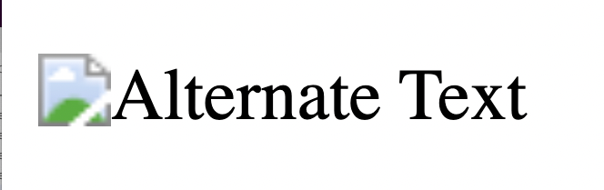
Images
An image is denoted by the <img> tag
<img src="url" alt=”Alternate Text”>
<img> | This is the tag used to define images
src="url" | This defines the path/location of the image. This can be a url or a path to the image
alt=”Alternate Text” | The alt attribute provides alternate text for the image. This is in the case that the image cannot be viewed

Slide 5
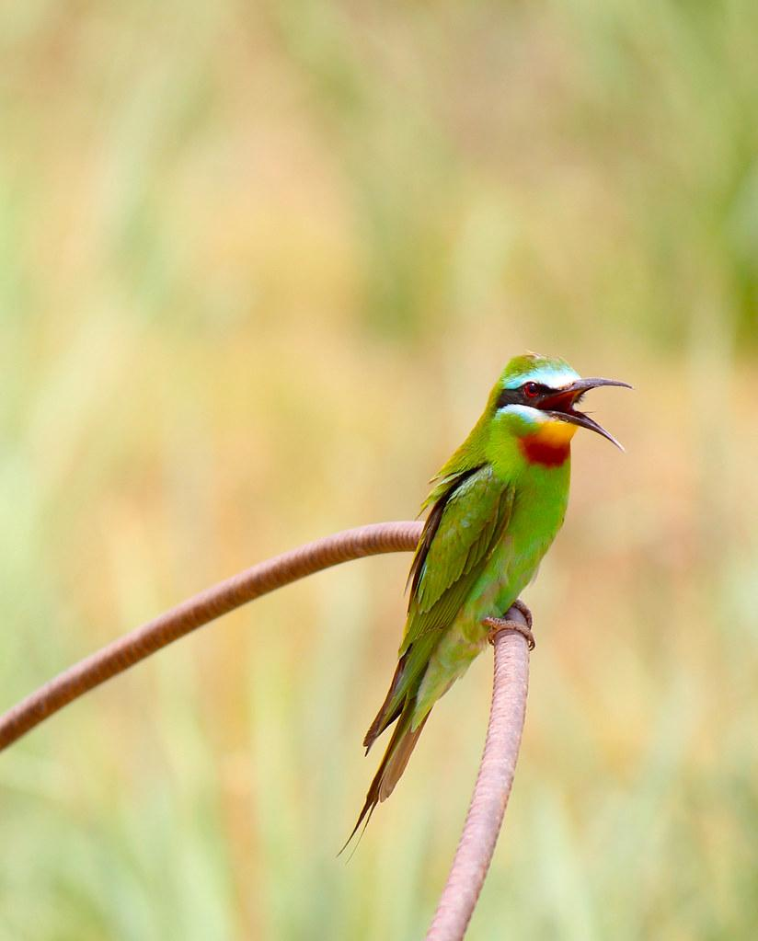
Images
Image in the same folder as HTML
If the image is located in the same folder as the HTML file, we have to just input the image name in “src” in order to display the image
How to display this?
Parrot.jpg

Slide 6
Images
Image in the same folder as HTML
If the image is located in the same folder as the HTML file, we have to just input the image name in “src” in order to display the image
<img src="parrot.jpg" alt=”parrot”>
Parrot.jpg

Slide 7
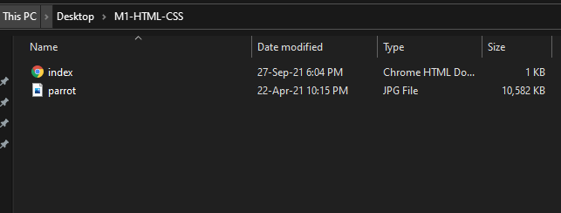
Images
Explanation
(Image in the same directory as html)

Slide 8
Images
Image in different folder relative to HTML
If the image is located in a folder “New Folder” that is in the same directory as the HTML file, what do we write in the src?
How to display this?
Parrot.jpg
(This image is inside New Folder)

Slide 9
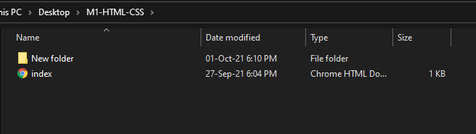
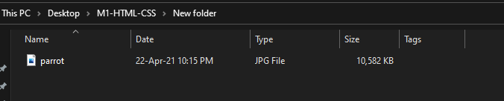
Images
Explanation
After entering New Folder

Slide 10
Images
Image in different folder relative to HTML
If the image is located in a folder “New Folder” that is in the same directory as the HTML file, what do we write in the src?
<img src="/New Folder/parrot.jpg" alt=”parrot”>
Parrot.jpg
(This image is inside New Folder)

Slide 11
Image Tags Variations
Notes:
Without further adieu, Let’s look at the course introduction so that you will know what you are going to learn.

Slide 12

Images
Image Dimensions
If we type the following HTML, the image would be displayed as width 500px and height 500px
<img src="url" alt=”alternatetext” width=”500” height=”500”>
Be Careful about Ratio
If you are putting in a wrong aspect ratio
H:500px, W:600px
H:500px, W:500px
Disclaimer: This technically falls under styling and CSS. Here is just a quick introduction only.

Slide 13
Images
Image as Links
We have learnt about <a> tags before which serves as links. Similarly, we can also make an image into a clickable link by wrapping it with <a></a> tags.
<a href="www.google.com">
<img src="url" alt="HTML tutorial" width=”500” height=”500”>
</a>
If this image is clicked, we will be redirected to google.com!

Slide 14

That’s all for this module!
THANK YOU!

